Slide 1
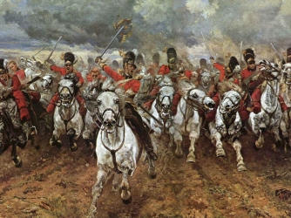
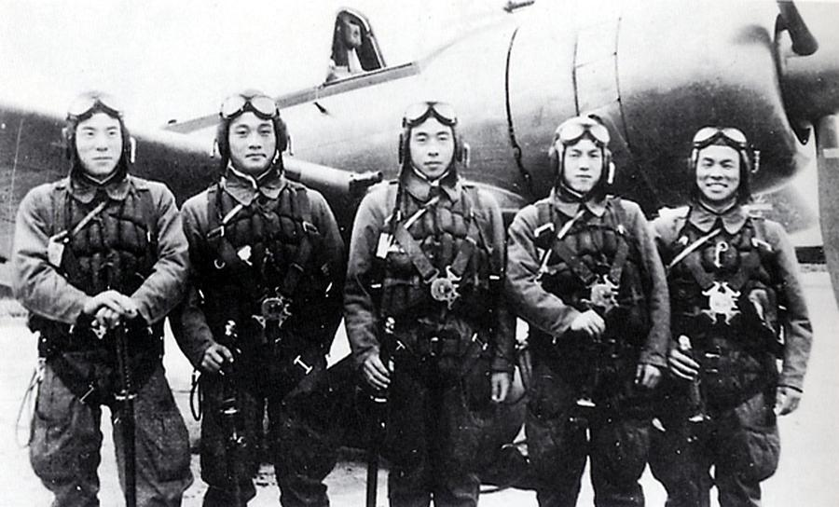
Starter: Remind yourself of Charge of the Light Brigade and Kamikaze

Slide 2

Assessment Objectives
AO1: Read, understand and respond to texts. Students should be able to: maintain a critical style and develop an informed person response; use textual references, including quotations, to support and illustrate interpretations.
AO2: Analyse the language, form and structure used by a writer to create meanings and effects, using relevant subject terminology where appropriate.
AO3: Show understanding of the relationships between texts and the contexts in which they were written.
AO4: Use a range of vocabulary and sentence structures for clarity, purpose and effect, with accurate spelling and punctuation.
Notes:
Resource 1. Additional help for this task can be found on p. 6 & 7 in the poetry student book.

Slide 3
Date:1842
Power & conflict
Title: Charge of the Light Brigade
Poet: Alfred, Lord Tennyson
Main Idea/ Theme:
The soldiers of the Light Brigade deserved to be honoured for their bravery and obedience
Language/ Form:
Repetition
Sibilance
Consonance
Anaphora
Ballad
Imperative verbs
Dual meanings
Imagery:
Biblical/ classical imagery about venturing into death and hell
Context: Written based on an account of the Battle of Balaclava from the Times.
Tone: Reflective/ narrative
Rhythm/ Rhyme:
Dactylic dimeter/ no formal rhyme scheme

Slide 4
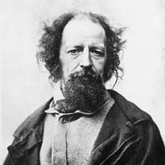
Alfred, Lord Tennyson
AO3 Text-Context Link
Seen as the defining poet of the Victorian era (the dates of his life almost match with Queen Victoria).
He was made a lord for his poetry and was also made poet laureate after the death of William Wordsworth. He held the post for 42 years (the longest ever).

Slide 5
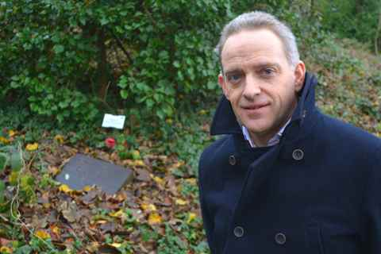
What actually happened?
AO3 Text-Context Link
The Battle of Balaclava (Crimean War), 1842
The Light Brigade (Light Cavalry unit) were mistakenly ordered to make a frontal assault on a well-prepared artillery unit instead of harrying a retreating artillery battery (this was the original order).
They rode their unarmoured horses into a heavily defended Russian line and returned but took losses of over two thirds.
A volunteer with the cleared grave of Sergeant Major James Henry Kelly. Fellow Light Brigade survivor Anthony Wilder is also buried at Arnos Vale.

Slide 6
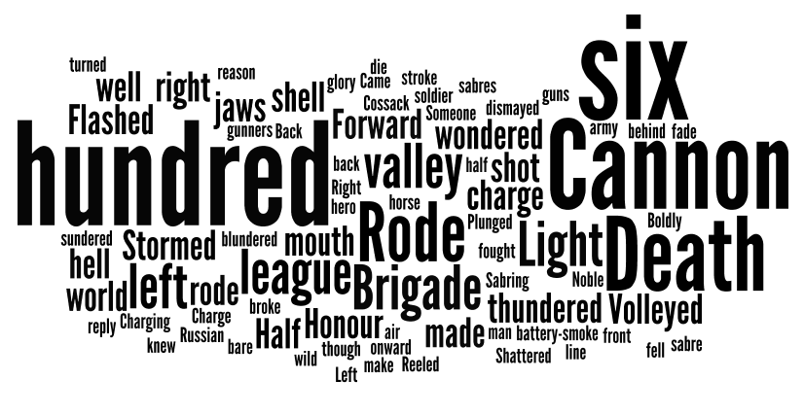
Spotting the repeated ideas

Slide 7
Language
A02 – Analysing language, sentence structures and form used by the writer to create effect
Repetition – ‘Cannon’
Alliteration – ‘horse and hero’
Biblical reference – Psalm 23
Language choices with dual meanings – e.g. ‘wondered’
Words which describe sounds – e.g. ‘thundered’

Slide 8
What do these words have in common?
Blundered
Thundered
Wondered
Sundered

Slide 9
A01 – A critical response using quotations
Blundered
Thundered
Wondered
Sundered
Erred = made a mistake

Slide 10
Rhythm/ Rhyme
A02 – Analysing language, sentence structures and form used by the writer to create effect
Dactylic dimeter (you don’t have to explain what this is in your response). The poetic feet of this poem goes like this:
‘Forward, the Light Brigade!’
The only place this is not the case is on the word ‘blundered’.

Slide 11
Themes/ Tone
A02 – Analysing language, sentence structures and form used by the writer to create effect
Is this poem about:
The heroism of the soldiers of the Light Brigade?
or
A criticism of the mistakes made by the upper class officers in the army?

Slide 12
Date: 2007
Conflict
Title: Kamikaze
Poet: Beatrice Garland
Main Idea/ Theme:
Regrets about conflict
Returning home
Language:
Sensory language
Multiple speakers
Alliteration
Simile
Metaphor
Direct speech
Imagery:
Fishing and the sea
Context:
A daughter is telling her children about her father and how he turned back from a one-way flight in WWII
Tone: Storytelling
Rhythm/ Rhyme: No specific patterns allows conversational tone

Slide 13
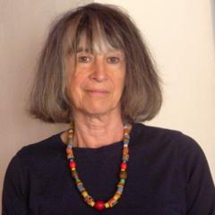
Beatrice Garland
Part –time poet, part time NHS clinician.

Slide 14

Culture of obedience and honour
In Japan, during WWII, the culture of Bushido was still very prominent. This linked to obedience, loyalty, honour and patriotism. This was not necessarily the original Bushido code but had been altered by the government and military to suit their own purposes in war.
The order of the samurai followed this code which encouraged pilots to engage in suicide attacks for the glory of Japan.
Men who failed to follow this ideology, like the pilot in the poem, would have been shunned by their family and were encouraged to commit ritual suicide (suppuku).

Slide 15
Comparing the poems
Feature/ technique | The Charge of the Light Brigade Alfred, Lord Tennyson | Kamikaze Beatrice Garland
Honour in dying in battle for your country, no matter how senseless the losses | The men die for no real reason or gain other than remaining obedient to the orders of their officers. They are praised for this obedience rather than mourned as a senseless waste of life. | Her father fails in his ‘duty’ to his country, choosing to return home to his family. His family reject him instead of welcoming him home and instead he endures a slow and silent death in isolation.
Other poems | Exposure | The Emigree, Bayonet Charge, Poppies

